Slide 1
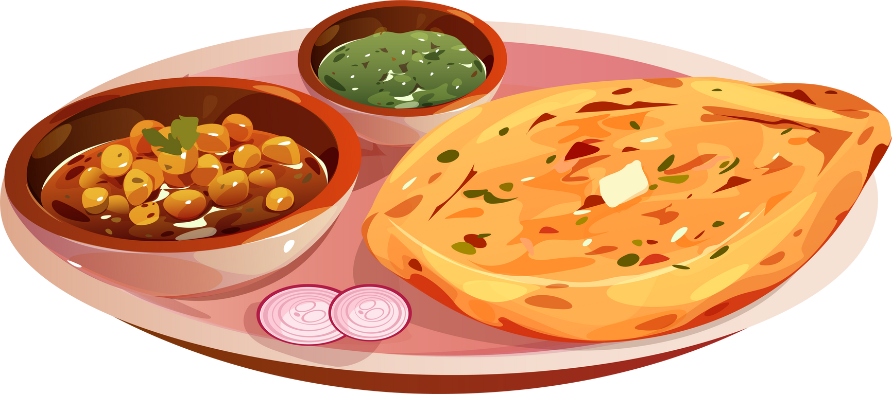






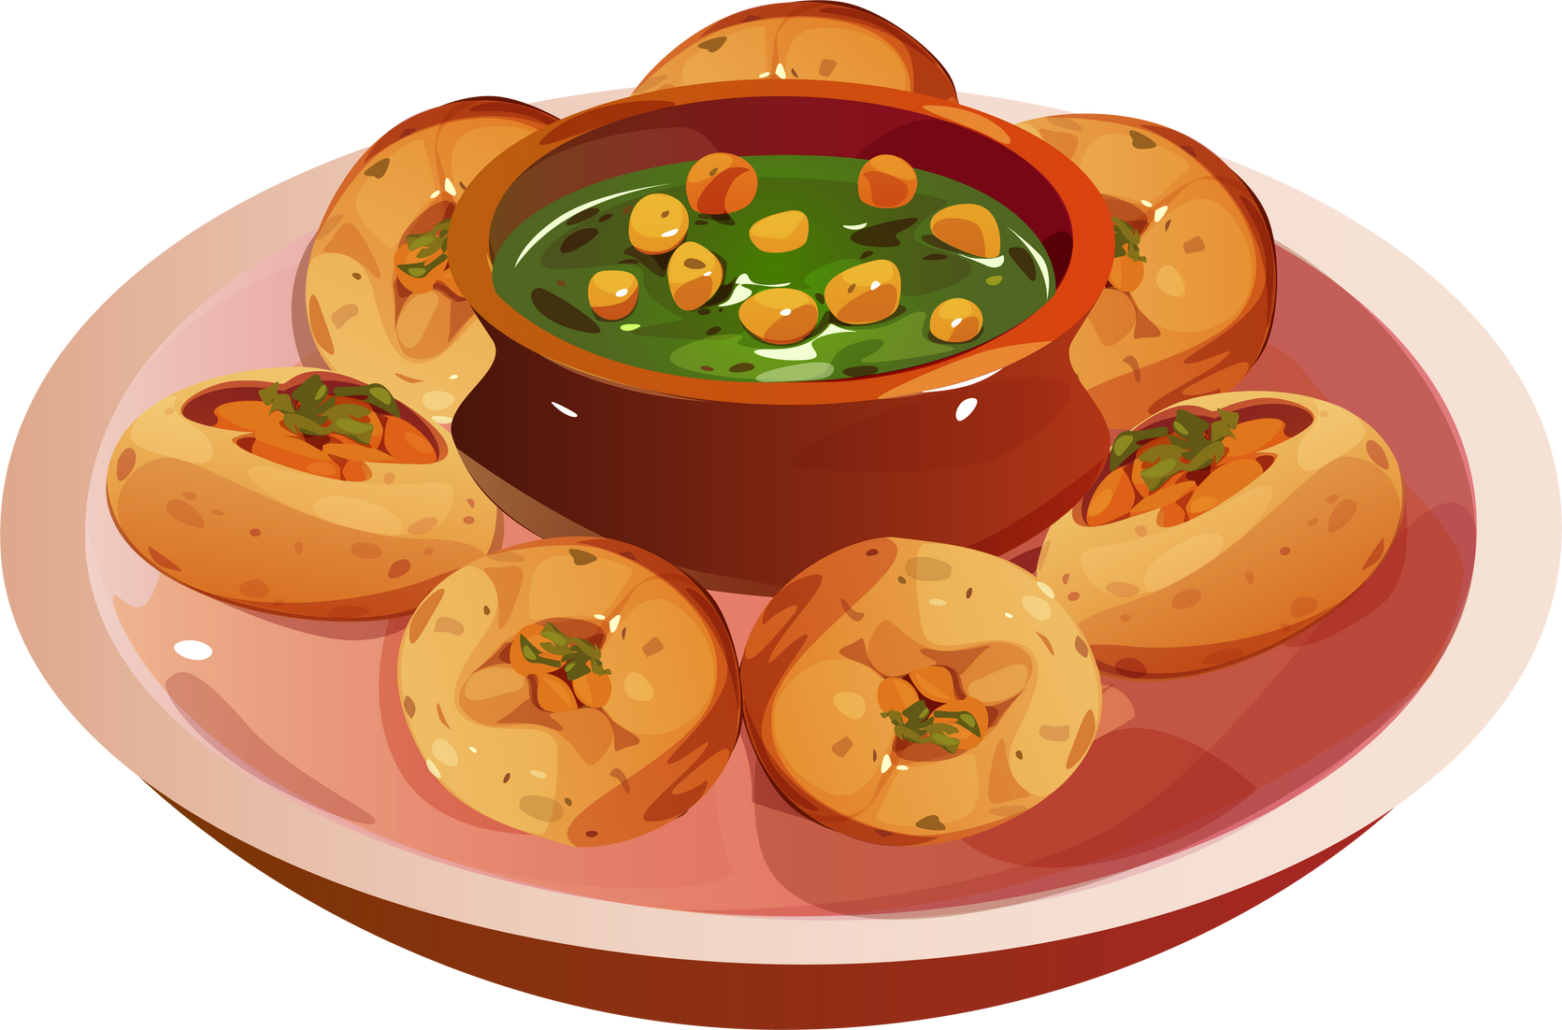
FLAVOURS

Slide 2
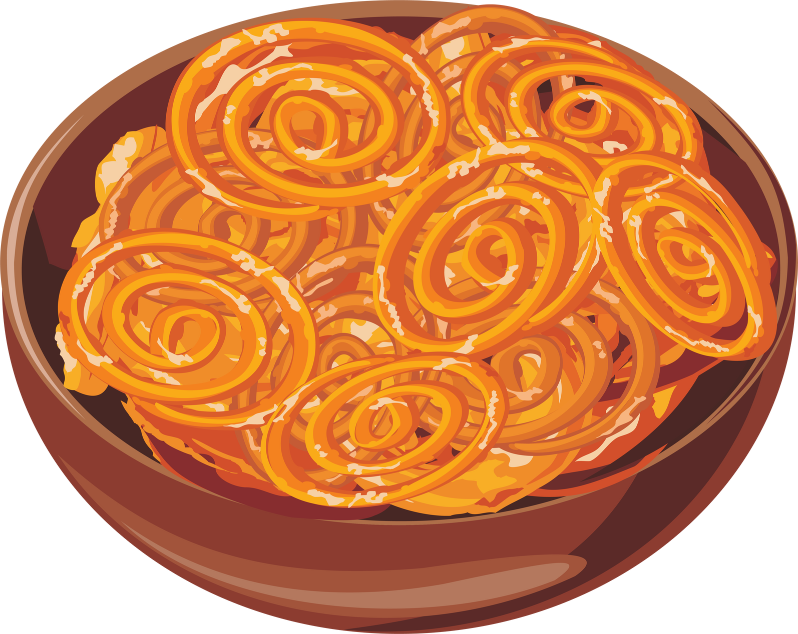
Indian Food Culture: A Visual Taste of Tradition
A DATA VISUALIZATION PROJECT EXPLORING CULINARY PATTERNS & REGIONAL DIVERSITY
Presented by: Deepa Nayak
Intern – CodeAlpha Technologies

Slide 3
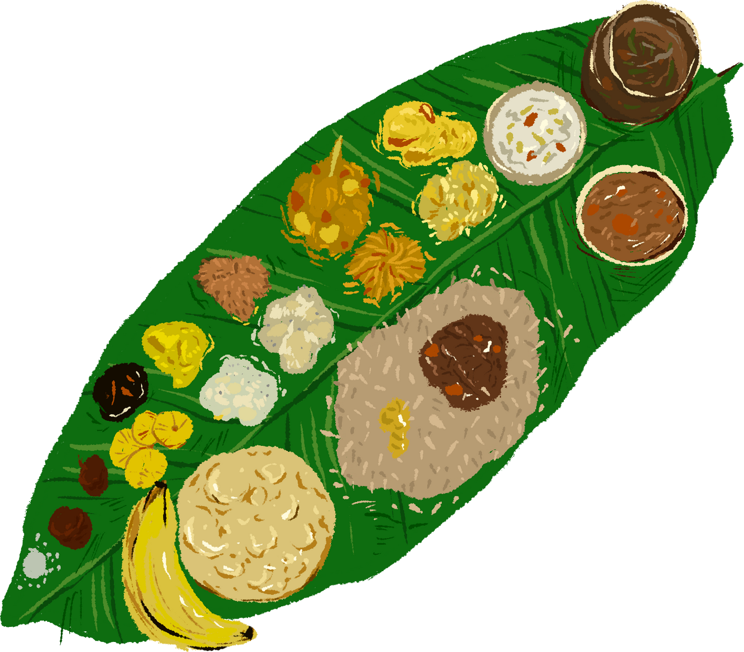
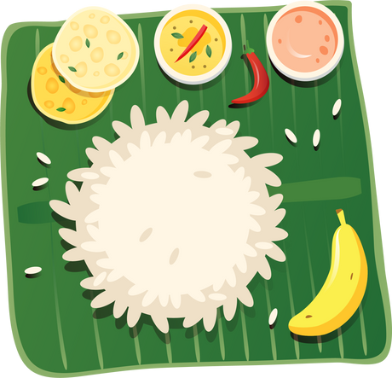
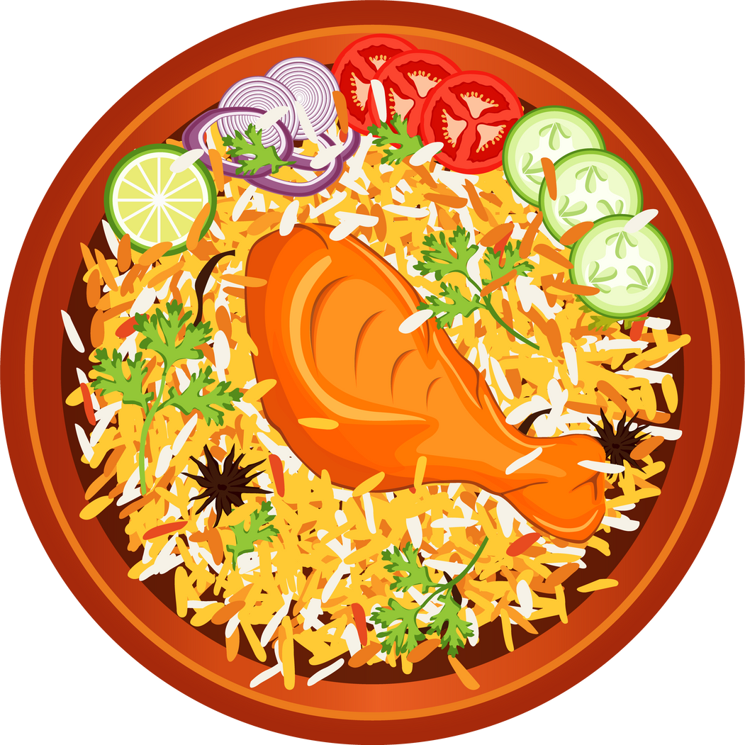
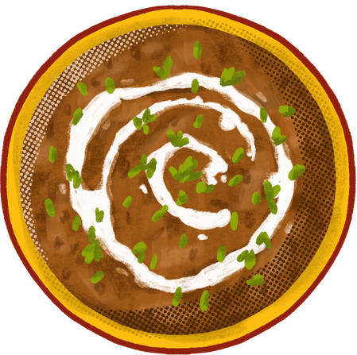
PROJECT OVERVIEW
Content
Objective: To visually analyze and explore regional, dietary, and cooking time trends in Indian cuisine using Power BI.
Dataset: Indian Food 101 – 255 traditional dishes with information on ingredients, diet, course, flavor, and time.
Tools Used: Python (for EDA), Power BI (for interactive visualization)

Slide 4
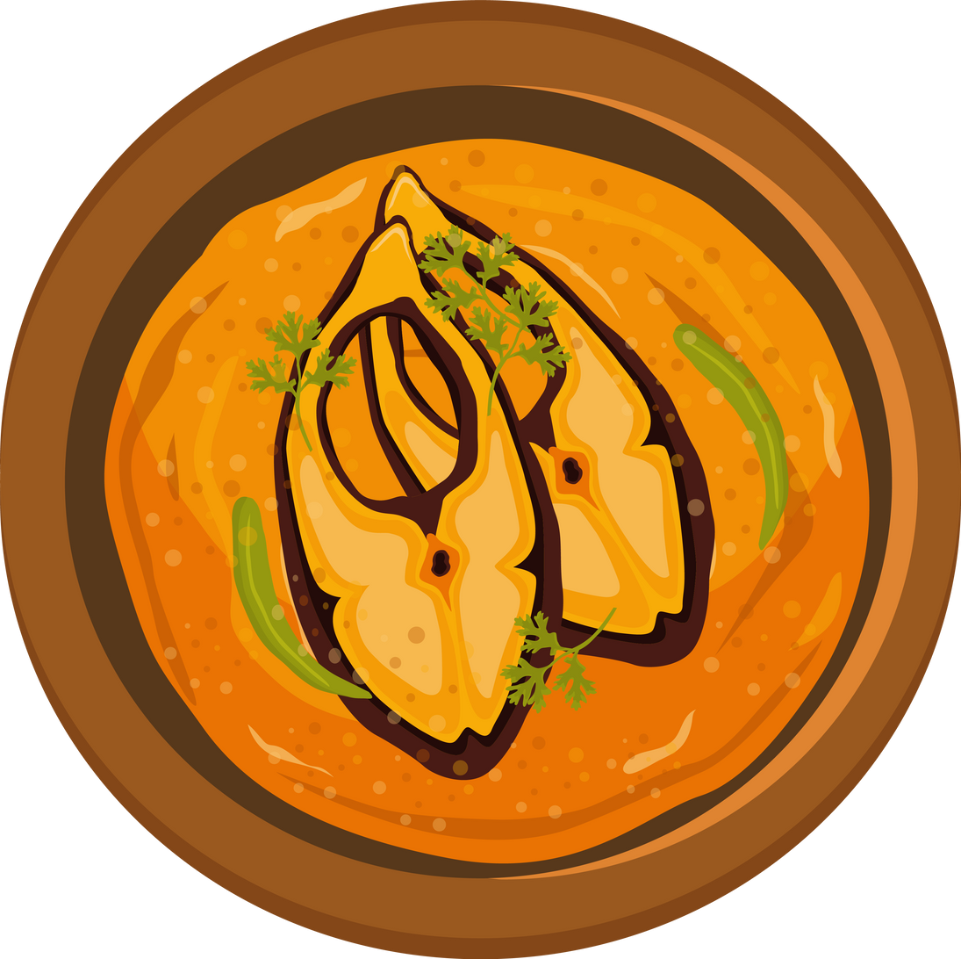
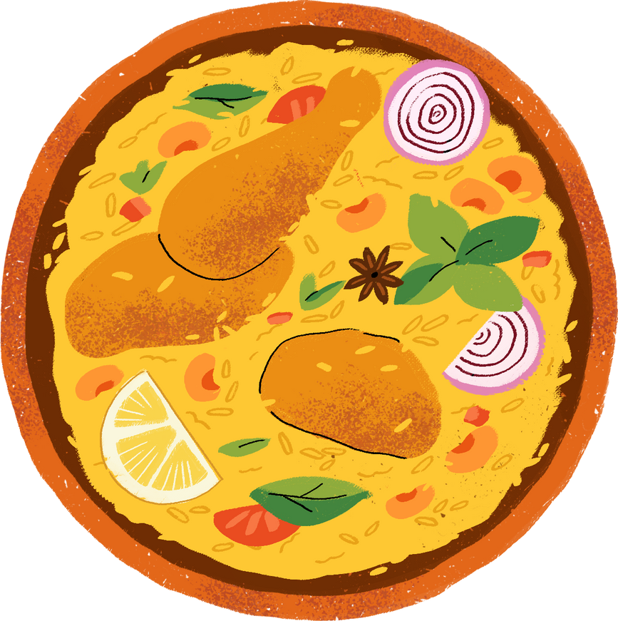
KEY INSIGHT #1 – DOMINANCE OF
VEGETARIAN CUISINE
Over 80% of dishes in the dataset are vegetarian.
Reflects the strong cultural preference for plant-based meals.
A core trait across all Indian regions.

Slide 5
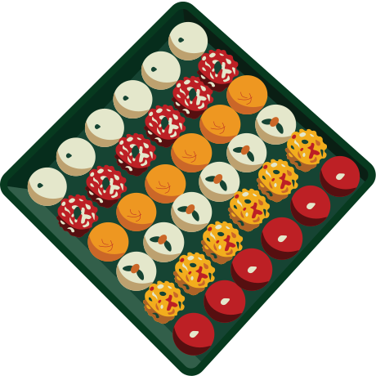
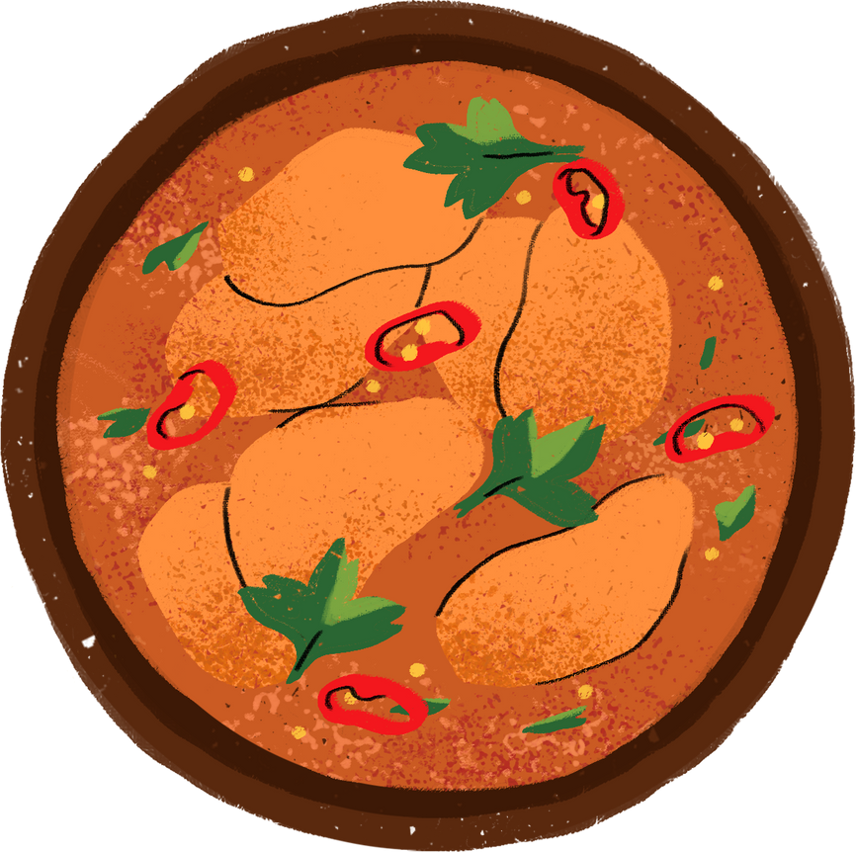
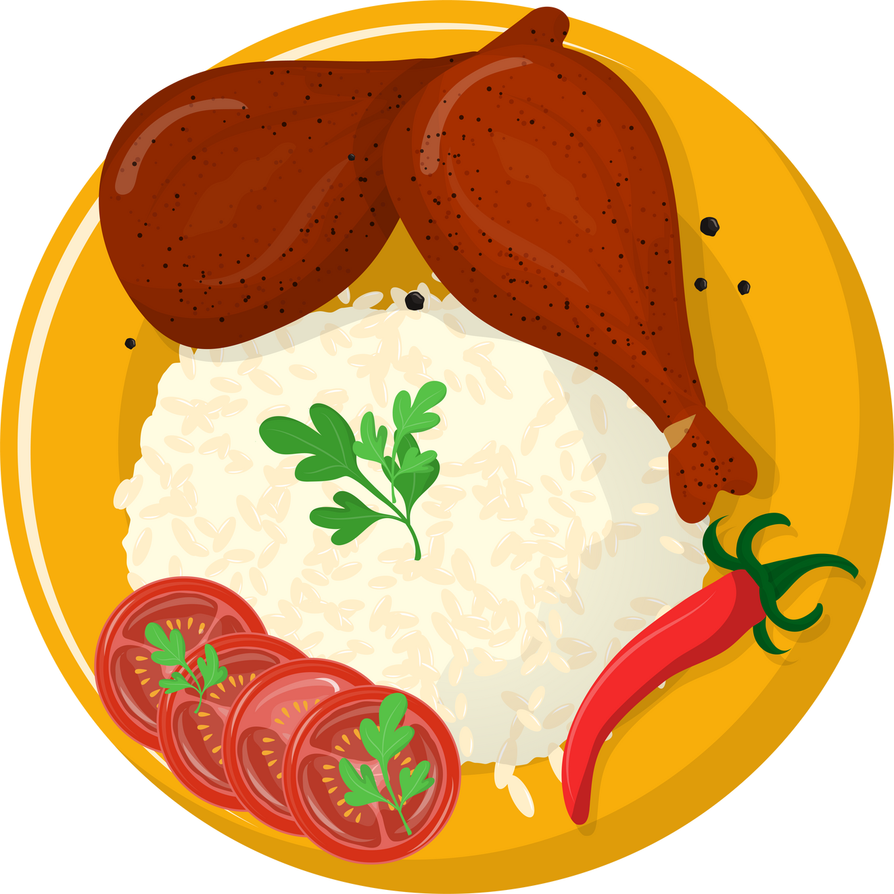
KEY INSIGHT #2 – SNACK &
Main Courses are most Popular
Snack and Main Course dishes dominate across regions.
Breakfast and Dessert categories are region-specific but less frequent.
Highlights a focus on flexible, day-long eating styles.

Slide 6
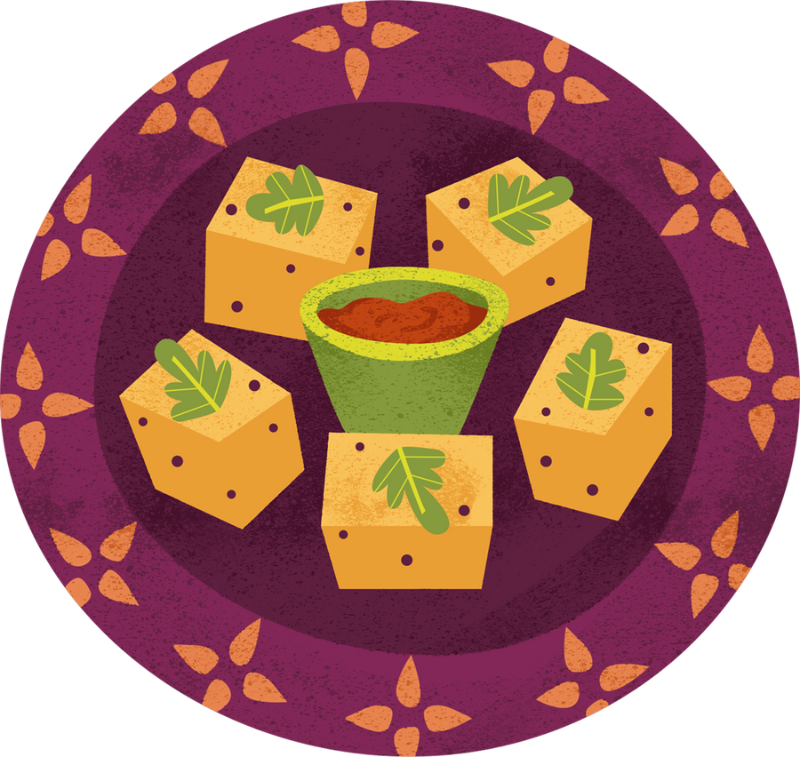
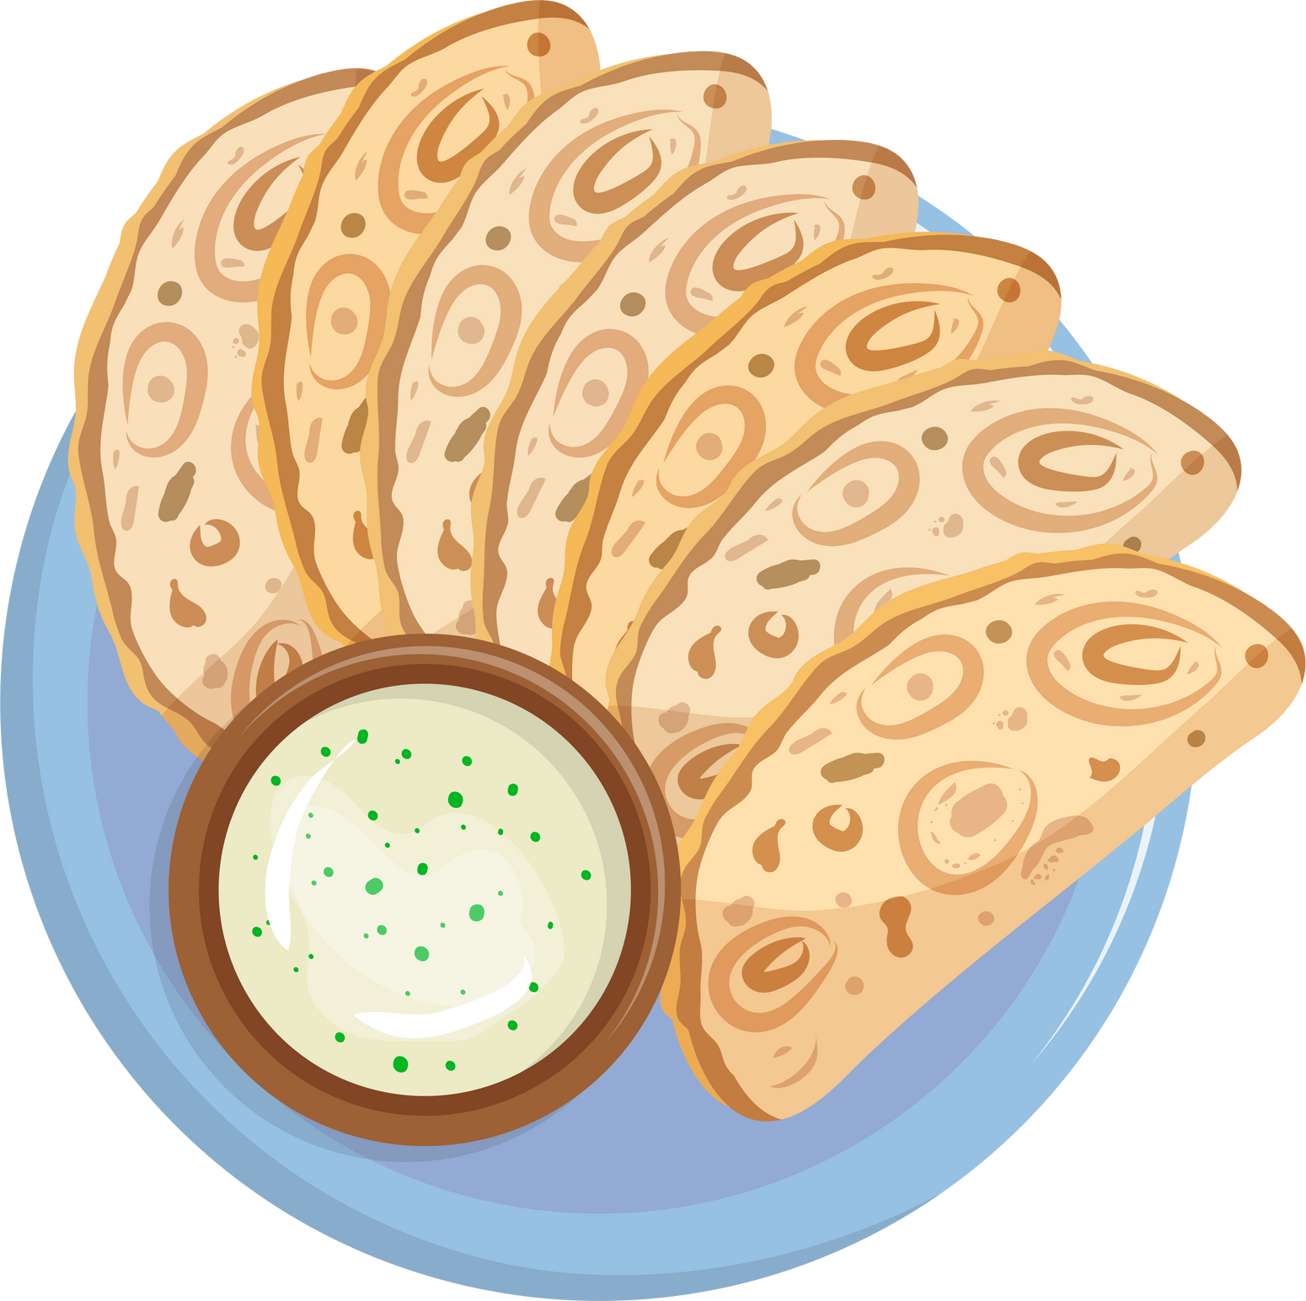
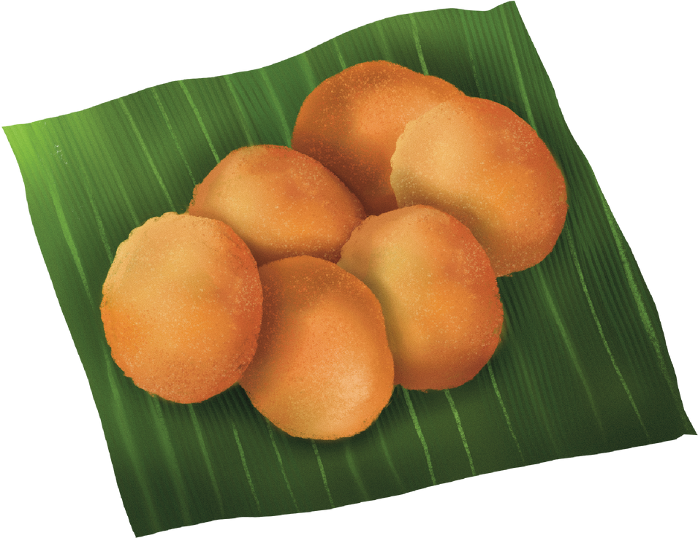
KEY INSIGHT #3 –
STRONG REGIONAL DIVERSITY
North India has the highest number of dishes.
Gujarat, Maharashtra, Punjab are the top 3 states.
Course variety is well distributed across zones.

Slide 7
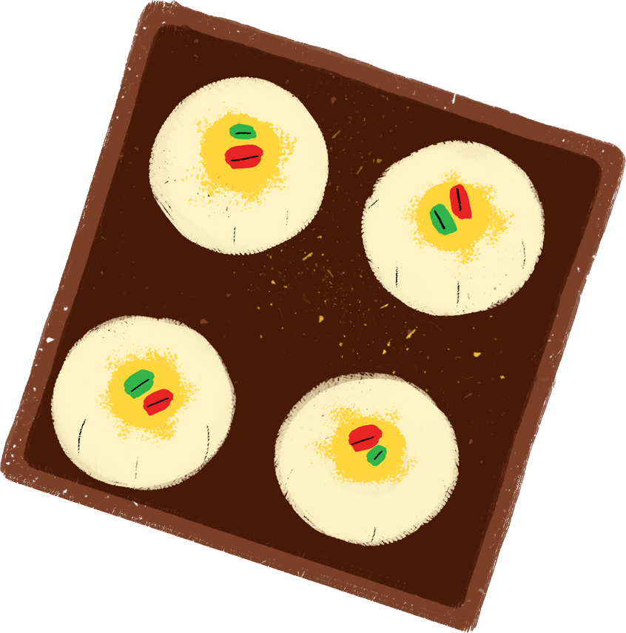
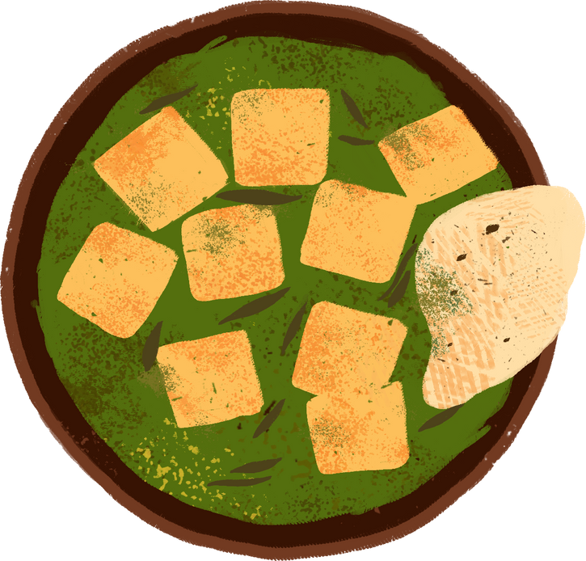
KEY INSIGHT #4 –
DISTINCT FLAVOR PREFERENCES
Spicy is the most dominant flavor profile.
Followed by Sweet, Tangy, and Bitter (used in limited states).
Indicates high spice complexity in Indian food.

Slide 8
KEY INSIGHT #5 – FAST-COOKED, TIME-SMART DISHES
Most dishes take less than 30 mins to cook.
Avg. Prep Time: ~15 mins, Cook Time: ~25 mins
Makes Indian cuisine highly adaptable for everyday cooking.

Slide 9

INSIGHT #6 – QUICK STATS THAT TELL A BIGGER STORY
The dataset includes 254 unique Indian dishes representing all major regions.
Uses 250+ unique ingredients, showcasing culinary depth and diversity.
4 different course types, from snacks to desserts to breakfast dishes across 25 total states and 6 regions.
Prep time averages at ~15 mins, while cook time averages around 25 mins, making most dishes time-efficient.

Slide 10
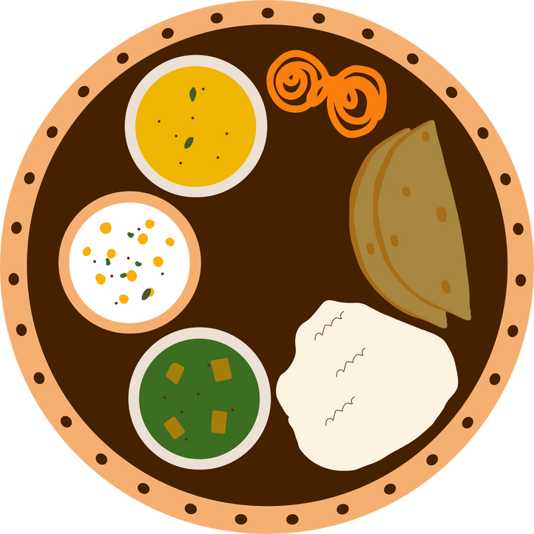
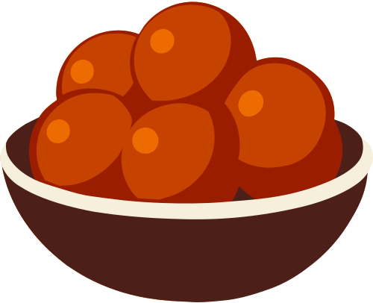
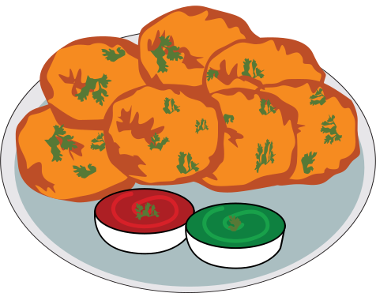

POPULAR COURSE TYPE
MAIN COURSE
DESSERT
SNACKS
STARTER

Slide 11
CONCLUSION
Indian cuisine combines diversity, tradition, and efficiency.
Data reveals not just patterns, but deep cultural reflections.
This project sharpened data storytelling, Power BI layout design, and insight communication.

Slide 12
LEARNINGS
Visual storytelling highlighted dietary simplicity and regional richness in Indian cuisine.
Power BI enabled intuitive insights through interactive exploration.
This project enhanced understanding of dashboard design, slicing, and analytical thinking.

Slide 13




FEEL FREE TO EXPLORE THE DASHBOARD OR VISIT THE GITHUB REPO:
🔗HTTPS://GITHUB.COM/DEEPANAYAKTANGODU/INDIAN-FOOD-DATA-VISUALIZATION
📬 Contact: deepanayak109@gmail.com
🔗 LinkedIn: www.linkedin.com/in/deepa-nayak-a825a7175

